Slide 1

COVID-19 PubSeq:
Public SARS-CoV-2 Sequence Resource
Andrea Guarracino, Peter Amstutz, Thomas Liener, Michael R. Crusoe, Adam Novak, Erik Garrison, Tazro Ohta, Bonface Munyoki, Danielle Welter, Sarah Zaranek, Alexander (Sasha) Wait Zaranek, Pjotr Prins
Bioinformatics Community Conference 2020
July 19-21 (West) / July 20-22 (East)
Notes:
Speech (about 20 seconds)
Hi everyone, I am Andrea Guarracino, a PhD student from University of Rome Tor Vergata. In this talk I am going to present to you COVID-19 PubSeq, a public sequence resource for SARS-CoV-2 virus sequences where data, metadata and analysis tools live together, publicly and freely.

Slide 2






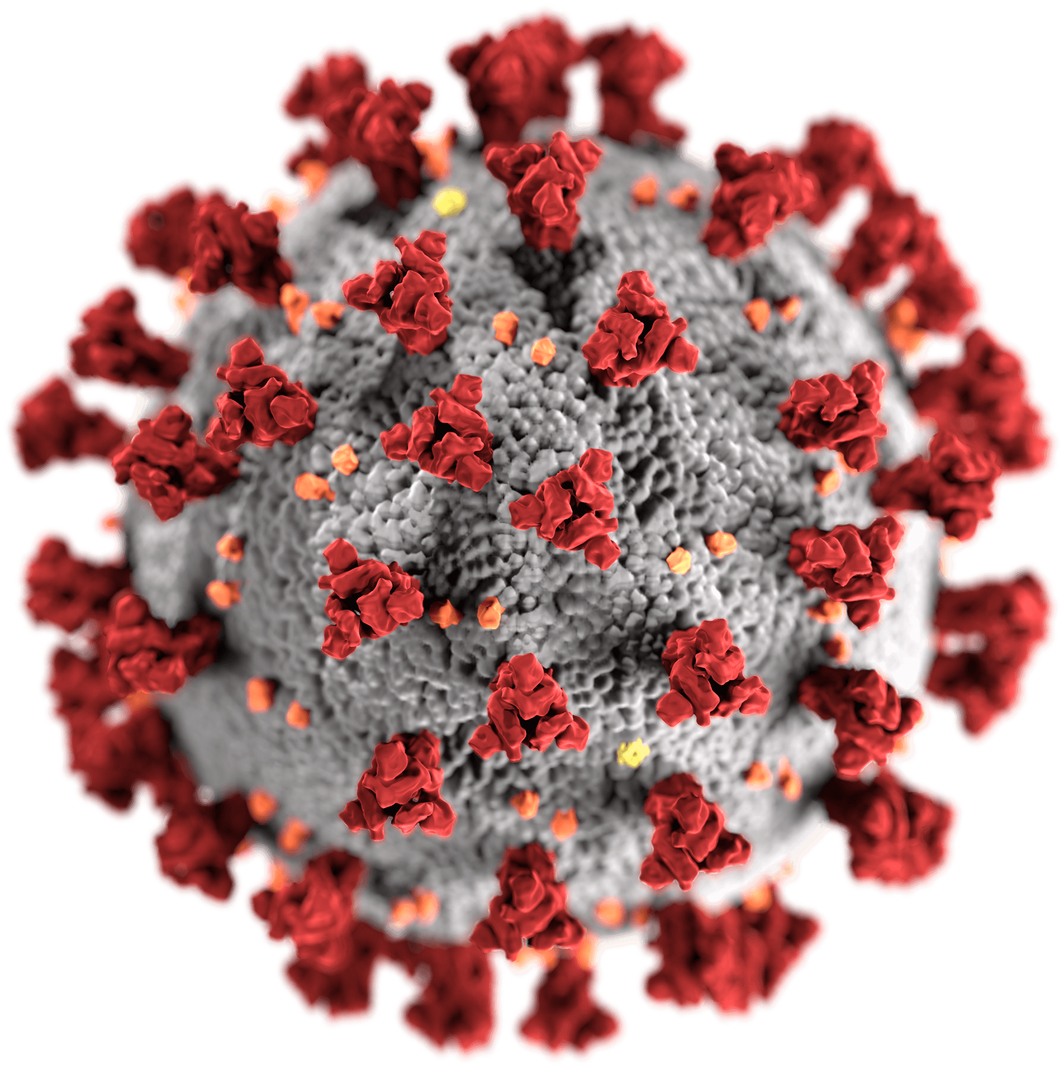


Data and analysis tools together
https://www.ebi.ac.uk/ena
Data with metadata
https://www.gisaid.org
COVID-19
PubSeq
https://www.ncbi.nlm.nih.gov
http://covid19.genenetwork.org
Tools
https://nextstrain.org
Slide 1 of 7
Notes:
Speech (about 45 seconds)
Existing data repositories allow free sharing data, but don’t enforce strict quality control on the submitted data and its metadata, and don’t add value in terms of running additional analysis. Moreover, some databases have a restricted license which prevents data from being used in online web services and on-the-fly computation, hindering research. Our idea was to create a repository that had a low barrier to entry for uploading and analyzing sequence data all in one place, without imposing any restriction on their utilization. For this aim, we created COVID-19 PubSeq.
Old speech
Indeed, the advancement of next generation sequencing technologies has a significant impact on medical and genomic research, producing massive amounts of data. However, in order to effectively exploit this data, the development of services that allow for a systematic exchange and analysis is required. Existing data repositories allow for free sharing data, but do not enforce strict quality control on the submitted data and its metadata, and do not add value in terms of running additional analysis. Moreover, some databases have a restricted license which prevents data from being used in online web services and on-the-fly computation, hindering research. Our idea is to create a repository that had a low barrier to entry for uploading and analyzing sequence data all in one place, without imposing any restriction on their utilization. For this aim, we created COVID-19 PubSeq.

Slide 3







State-of-the-art standards
Wilkinson, Mark D., et al., 2016
http://www.ontobee.org
http://commonwl.org
http://arvados.org
https://creativecommons.org
Ontology Lookup Service
https://github.com
Slide 2 of 7
Notes:
Speech (about 40 seconds)
This resource is designed to abide by FAIR data principles. Data are published with creative commons attribution licenses, and structured metadata are validated against standard ontologies. The workflows are written in Common Workflow Language using best practises: they are standard, shareable, reproducible, and, importantly, everyone can add new workflows to offer new functionalities. COVID-19 PubSeq is currently running on Arvados, a cloud open source platform for managing, processing, and sharing scientific and biomedical data.
Possible questions:
Are there other languages other than CWL? No, but we will evaluate adding other possibilities depending on how the developer community will react and on its desire to add new workflows to offer new functionalities.
Do you support more licenses? Not at the moment, but I’d like to point out that our intention is to support only licenses that don’t put restriction on data utilization, forever.

Slide 4
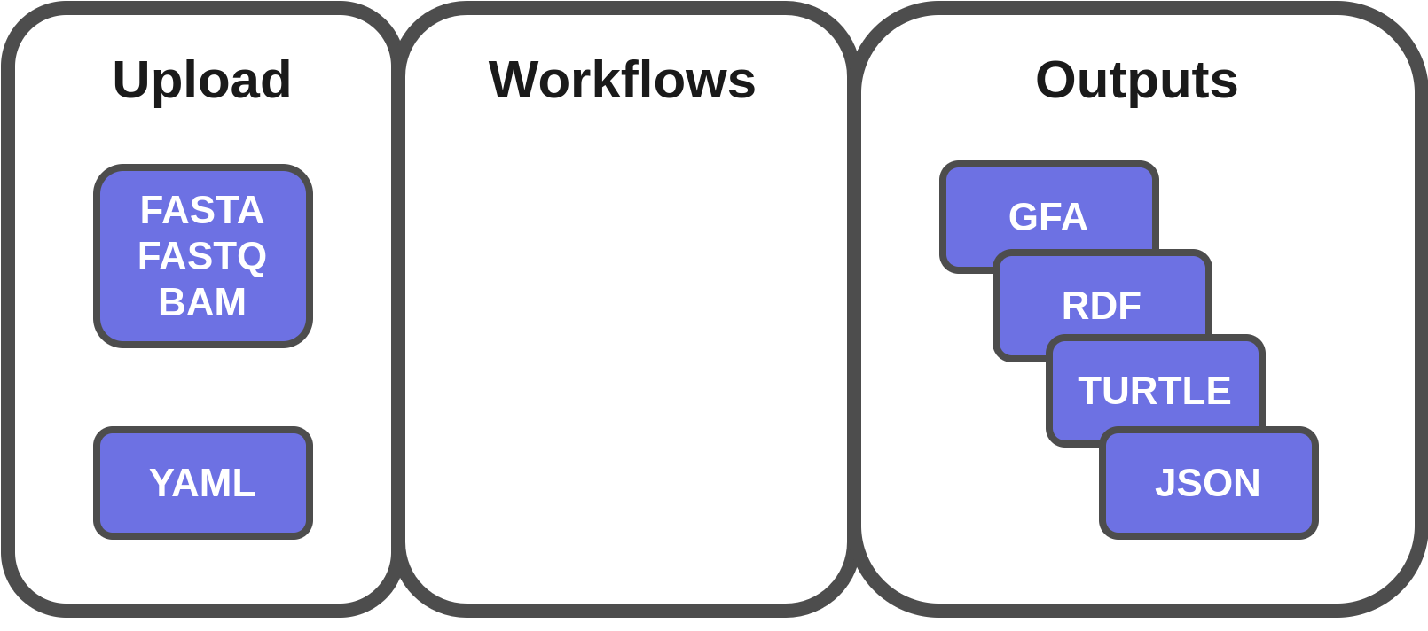

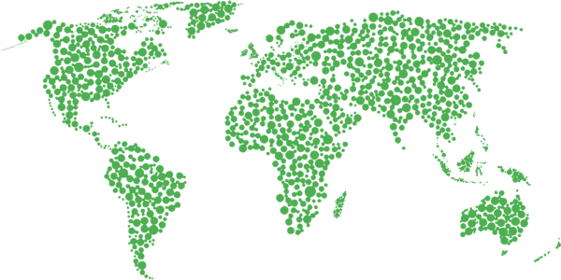

Overview
Slide 3 of 7
Notes:
Speech (about 42 seconds)
The data uploader can be used from a command line or a web interface without installing any software. The metadata are in the form of YAML files and are strictly validated against a schema. Data are validated for being in a supported data format, and for not being duplicated entries in the resource. Importantly, the available workflows are executed after the upload in order to provide up-to-date results rapidly and in standardized data formats. To date, these outputs are already used by two teams.
Removed phrases
We implemented a python-based uploader that authenticates with the Arvados platform using a token.

Slide 5
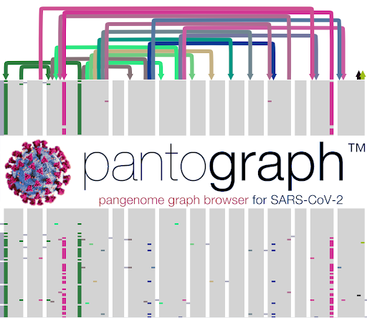
Pangenome Graph Browser
https://graph-genome.github.io
Courtesy of Thomas Townsley
Slide 4 of 7
Notes:
Speech (about 50 seconds)
The Graph Genome Browser Consortium uses the JSON outputs as inputs for Pantograph, an interactive visualization of the SARS-CoV-2 pangenome. As pangenome we refer to the entire set of genomic elements in a given species or clade. They naturally express genome rearrangements, so Pantograph allows researchers to browse the entire genetic diversity in a SARS-CoV-2 population that would otherwise be underestimated. Each time someone uploads a valid sample on COVID-19 PubSeq, this input is immediately combined with all the already uploaded SARS-CoV-2 genomes in order to generate an up-to-date pangenome as input for Pantograph.

Slide 6
COVID-19 Integrated knowledge base
List everything known on a specific sample
Output
https://covid-19-sparql.expasy.org
PREFIX pubseq: <http://biohackathon.org/bh20-seq-schema#MainSchema/>
PREFIX sio: <http://semanticscience.org/resource/>
select distinct ?predicate ?object
{
?sample sio:SIO_000115 "MT326090.1" .
?sample ?predicate ?object .
}
predicate | object
http://edamontology.org/data_2091 | http://identifiers.org/insdc/MT326090.1#sequence
http://ncicb.nci.nih.gov/xml/owl/EVS/Thesaurus.owl#C25164 | "2020-03-21"
http://purl.obolibrary.org/obo/GAZ_00000448 | http://www.wikidata.org/entity/Q30
http://purl.obolibrary.org/obo/OBI_0001479 | http://purl.obolibrary.org/obo/NCIT_C155831
Original GenBank submission
Collection date
United States of America
Nasopharyngeal
Swab Specimen
Slide 5 of 7
Notes:
Speech (about 35 seconds)
Moreover, the Swiss Institute of Bioinformatics has included COVID-19 PubSeq data in its knowledge base. Indeed, the uploaded metadata and the outputs are transformed into RDF databases. This means that is possible to query these data using SPARQL and ontologies. For example, this query tells us when the reported sample was submitted, and that it originates from the USA and is a biospecimen collected from the back of the throat by swabbing.

Slide 7
Community: developers + submitters
Shareable data
No licensing restrictions
SPARQL Endpoint
Integration with the SIB Knowledge base
Full metadata support
State-of-the-art ontologies
Free real work for you
Triggered on data upload
Slide 6 of 7
Notes:
Speech (about 45 seconds)
COVID-19 PubSeq is the result of a community effort: developers, but also submitters. There are several reasons why you should upload your raw data to this resource. Make your data available to the widest audience possible quickly and without restrictions is really important for the scientific research, in particular during this COVID-19 pandemic. Indeed, we recommend uploading to EBI and NCBI resources too, using our data conversion tool. In this way, you only enter data once, making it public to multiple resources, and getting the results of the analysis from the workflows available on COVID-19 PubSeq.
Old speech
As part of the COVID-19 Virtual Biohackathon 2020, we formed an active working group, creating a functional prototype within just one week. During the same event, we started collaborations with other groups with the aim to add more functionalities. About the data, we are working to allow the upload of FASTQ and BAM files, and to offer workflows to prepare the sequence data for submitting in other public repositories, such as EBI ENA and GISAID. About the analysis tools, we are collaborating with XXX to create workflows to analyze the pangenome, XXX.

Slide 8
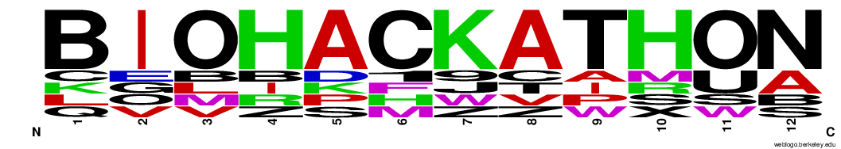




Acknowledgements
Peter Amstutz
Thomas Liener
Sarah Zaranek
Josiah Seaman
Eloi Durant
Adam Novak
Andrea Guarracino
Simon Heumos
Jack Tierney
Danielle Welter
Pjotr Prins
Jörg Hagmann
Tazro Ohta
Erik Garrison
Jerven Bolleman
Travis Clark
Alexander (Sasha) Wait Zaranek
Stacie Seaman
Michael R. Crusoe
Hannah Sewell
Bonface Munyoki
Torsten Pook
Robert Fornof
Núria Queralt-Rosinach
Philippe Rocca-Serra
Dmytro Trybushni
Christian Kubica
Thomas Townsley
Paul Schofield
Robert Hoehndorf
Jacob Windsor
Kaytie Innamorati
Mark Seaman
Susan Bello
Njagi Mwaniki
Claus Weiland
Toshiyuki Yokoyama
Artem Tarasov
Biohackathon groups
Public Sequence Resource
Pangenome
Ontology
Slide 7 of 7
Notes:
Speech (about 10 seconds)
Finally, I want to thank all the teams involved in this project for their hard work, and of course the audience for listening. Thank you very much.
Possible questions:
Are is it sostenible? Looking at all the persons involved… I think so! If this machine starts, it will grow more and more because it will be in the users' interest both to submit their data to analyze it and to add new features as workflows.
Old speech
We thank the COVID-19 Virtual Biohackathon 2020 and ELIXIR for creating a unique event that triggered many collaborations. We thank Curii Corporation for their financial support for creating and running Arvados instances. We thank Amazon AWS for their financial support to run COVID-19 workflows. We also want to thank the other working groups in the Virtual Biohackathon who generously contributed ontologies, workflows and software.

Slide 9
Reviewer 1
FAIRness of SASS-CoV-2 sequence is a real concern, since GISAID (the main archive of such data) has a license that forbids data reuse to build a web application, and its policy on API use is murky. This project is a nice step towards an unrestricted resource.
The open science part is explained wonderfully. What is missing is a description of how a community centered on this project can be assembled. Since the project has been born in a virtual biohackathon, the community is already there. Still, the abstract does not make that clear.
The website and the repo do not really make a good effort towards attracting new developers.
Reviewer 2
My one piece of feedback for the project (not the talk) is some people may prefer to go more open than just CC-BY. CC0 is even better practice, so it would be nice to offer the option to opt-in for more open.
Reviewer 3
The novelty of this abstract is that it provides the analysis tools and the data all in one place. Most other repositories I’ve seen I this realm either have the data analysis tools (e.g. Nextrain https://github.com/nextstrain/ncov) or the data (e.g. GISAID) but not both.
I didn't see an output example but I know what a pangenome is.
The computation is done on the cloud. I didn't want to a upload a test sequence (like the one of the reference strains) because I didn't know if that was appropriate (i.e. it could change the pan genome and I don't know what QC checks are in the pipeline).
This project lets the user upload Sars-Cov-2 viral sequences and then then it computes a pan-genome based on all the genomes available. The novelty of this abstract is that it provides the data analysis tools and the data all in one place. I think this abstract would make a good poster since a lot more functionality needs to be added to this project before it is widely used. For example, it would be nice if users could download the uploaded sequences, select which genomes to include/exclude in the pangenome data analysis, etc.
Could the authors provide a description of quality checks performed on the genomes that are uploaded? E.g., a check for duplicated entries.
Website
http://covid19.genenetwork.org
Repository
https://github.com/arvados/bh20-seq-resource

Slide 10
Notes
Include the poster number?
Notes from Pjotr
I would focus on why this project is needed and why it is important to have free software and open data for the wider scientific effort.
To me the automated workflows are a novelty, as well as the metadata, as well as the free software/open data initiative.

Slide 11
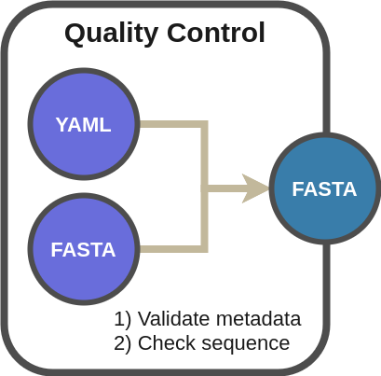

SARS-CoV-2 Pangenome: Upload
https://yaml.org
Notes:
Speech (about 40 seconds) The first workflow we implemented is the creation of a SARS-CoV-2 pangenome from FASTA files. Moreover, XXX.
Add fastq workflow

Slide 12
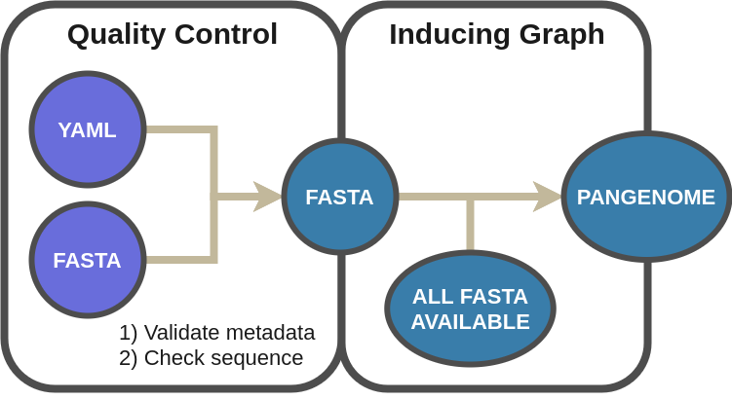
SARS-CoV-2 Pangenome: Analysis
https://github.com/ekg/seqwish
https://github.com/vgteam/odgi
Slide 4 of 8
Notes:
Speech (about 25 seconds)
When someone uploads a valid FASTA sequence, this input gets immediately combined with all the uploaded SARS-CoV-2 FASTA sequences in the storage in order to generate an up-to-date pangenome encoded in the form of variation graph. Variation graphs are sequence graphs which embed the linear sequences of the pangenome as paths in the graphs themselves.

Slide 13
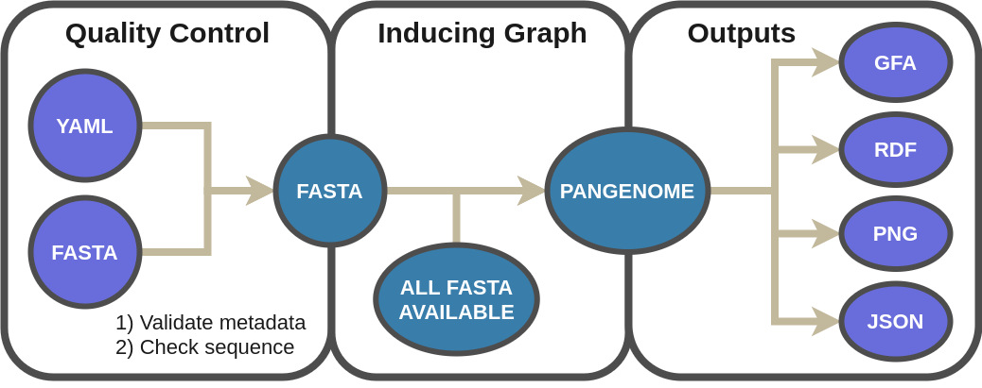
SARS-CoV-2 Pangenome: Outputs
http://gfa-spec.github.io/GFA-spec/GFA1.html
https://en.wikipedia.org/wiki/Resource_Description_Framework
Slide 5 of 8
Notes:
Speech (about 20 seconds)
The full pangenome is made available for download in useful standardized data formats for further analyses, including GFA and RDF formats, together a pangenome visualisation. The outputs include also JSON files which are the inputs consumed by the Pangenome Graph Browser.

Slide 14
PREFIX pubseq: <http://biohackathon.org/bh20-seq-schema#MainSchema/>
select distinct ?dataset ?submitter
{
?dataset pubseq:submitter ?id .
?id ?p ?submitter
}

Slide 15
Benefits
Working platform COVID-19 Biohackathon
April 5 2020 - April 11 2020
Multiple Sequence Alignment
???
We should put in evidence the collaboration with the other groups from the biohackathon
FASTQ/BAM upload
???
Phylogenetic tree
???
Slide 6 of 7
Notes:
Speech (about 30/40 seconds)
COVID-19 PubSeq is the result of a community effort. As part of the COVID-19 Virtual Biohackathon 2020, we formed an active working group, creating a functional prototype within just one week. During the same event, we started collaborations with other groups with the aim to add more functionalities. About the data, we are working to allow the upload of FASTQ and BAM files, and to offer workflows to prepare the sequence data for submitting in other public repositories, such as EBI ENA and GISAID. About the analysis tools, we are collaborating with XXX to create workflows to analyze the pangenome, XXX.

